Slide 1

Diamond deals
Unraveling the Metrics and Money in MLB Player Transactions
Hayden Ravert
Woz U

Slide 2
Background
Hayden Ravert
B.S. Astrophysics From Towson University
10 years of Retail Management
A lifetime of watching and analyzing Baseball

Slide 3

Project Question
What is the financial value of free agent players in Major League Baseball?

Slide 4
Determining A Players Value
Players Position
Pitcher vs. Position Player?
Player Statistics
Which statistics should we use?
Statistics vs. Salary
How do the stats influence salary?
Notes:
Pitcher – Starting or Relief
Position Player – All other positions other than pitcher C, 1B, RF, etc.
They also bat
Salary we will look at is the average yearly salary over the course of a contract

Slide 5
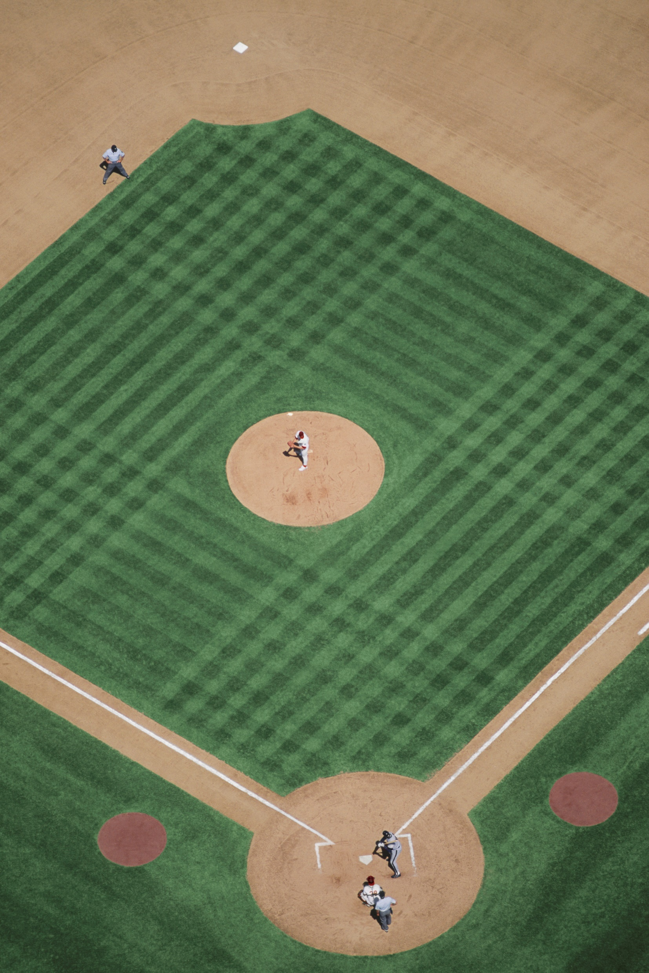
Pitcher
Stats
ERA – Earned Run Average
Number of Runs per nine innings (Lower Better)
WHIP – Walks and Hits per Inning
How well a pitcher keeps players off base (Lower Better)
-IP – Innings Pitched
Number of innings pitched over a season (Higher Better)
-W – Wins
Pitcher of record with a lead after five innings when starting or most effective relief pitcher (Higher Better)
-SV – Saves
Pitcher who gets the last three outs with a lead of no more that three runs (Higher Better)

Slide 6
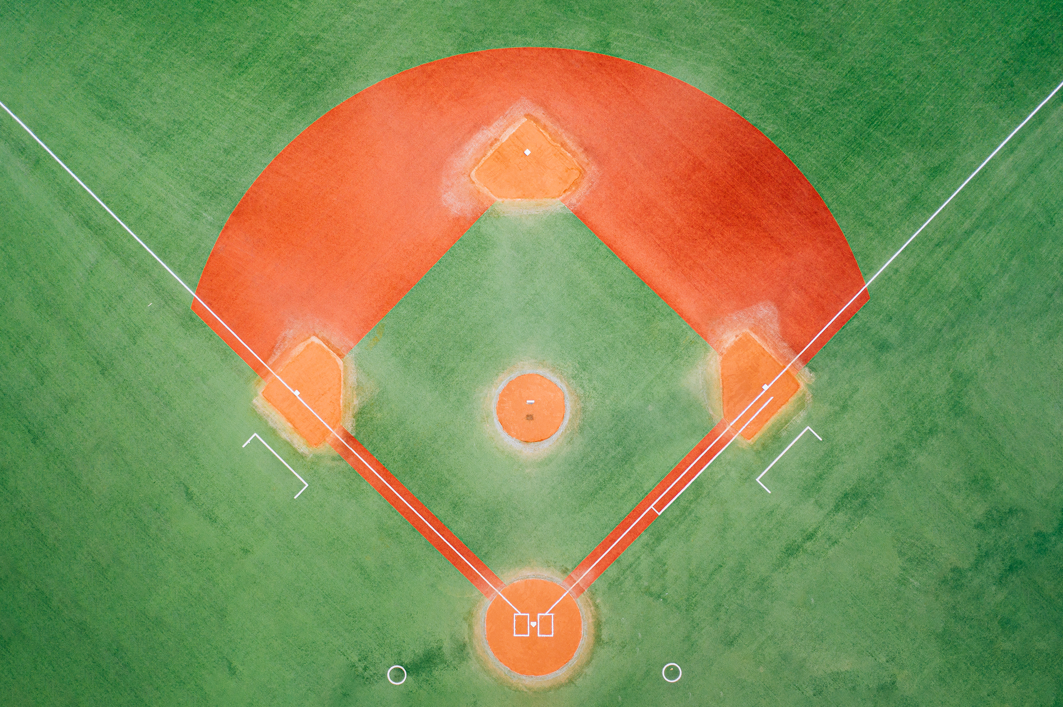
Position Players
Stats
H – Hits
When a player hits the ball in fair territory and reaches base (Higher Better)
RBI – Runs Batted In
When a player's plate appearance results in a run scored (Higher Better)
HR – Home Runs
When a player scores who hit the ball in fair territory (Higher Better)
AVG – Batting Average
Total Hits divided by Total At Bats (Higher Better)
OPS – On Base Percentage Plus Slugging
How well a hitter can reach base and how well he can hit for average and power (Higher Better)
Notes:
A position players stats are mostly reflected in how well they bat
They also have other stats based on how well they play the field but are mostly overlooked

Slide 7
WAR
Wins Above Replacement
Measures a player’s win value versus a replacement player at the same position(usually a Minor League replacement) (Higher Better)
WAR = (Batting Runs + Base Running Runs +Fielding Runs + Positional Adjustment + League Adjustment +Replacement Runs) / (Runs Per Win)
WAR = [[([(League “FIP” – “FIP”) / Pitcher Specific Runs Per Win] + Replacement Level) * (IP/9)] * Leverage Multiplier for Relievers] + League Correction
Notes:
WAR is a stat that both types of players have however it is calculated differently
Position based on batting
Pitcher based on how well they pitch

Slide 8
Gathering Data Methods
All data from spotrac.com
Free Agent Signings of seasons 2019-2023
Player, Position, Age, Bats, Throws, Team From, Team To, Years Signed, Total Salary, Average Yearly Salary
Stats of players from seasons 2018-2022
H, RBI, HR, AVG, OPS, IP, ERA, WHIP, W, SV, WAR
Starting with 679 Samples

Slide 9

Manipulating Data
Add Player Id column
Split the data into Pitcher and Position Player
Created dummy variables to match positions to separate
Drop irrelevant columns
Position, Bats, Throws, From, To
Drop missing values or change to 0
Pitchers
Age, Average Salary, Innings Pitched, ERA, WHIP, Wins, Saves, WAR
Sample Size 331
Position Players
Age, Average Salary, Hits, RBI, HR, AVG, OPS, WAR
Sample Size 278
Notes:
Position Dummy variable are split into player position on the field, 1=Pitcher, 2=Catcher, 3=1st Base, etc.
What hand they throw with or side of the plate they hit from is irrelevant for the time being
Also, they're last team and new team is also irrelevant.
Any N/A Salaries or WAR’s listed need to be dropped
N/A Saves is changed to 0
Minimum of 85 samples needed was found after looking at G Power.

Slide 10
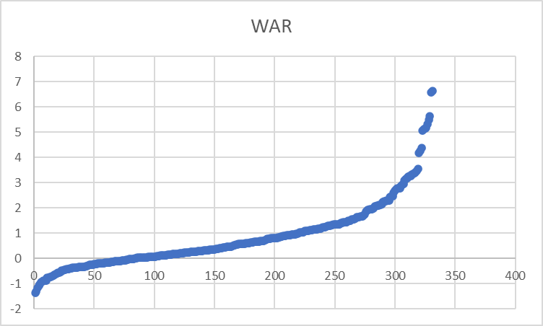
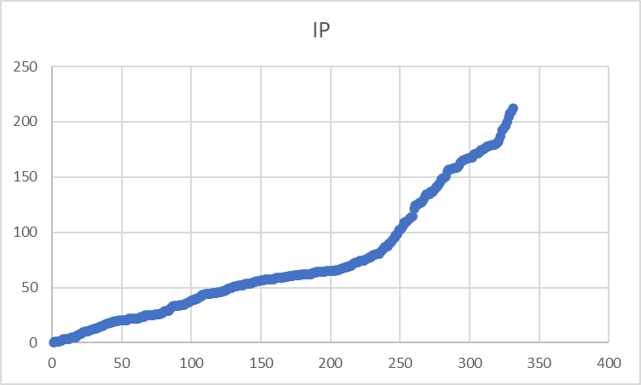
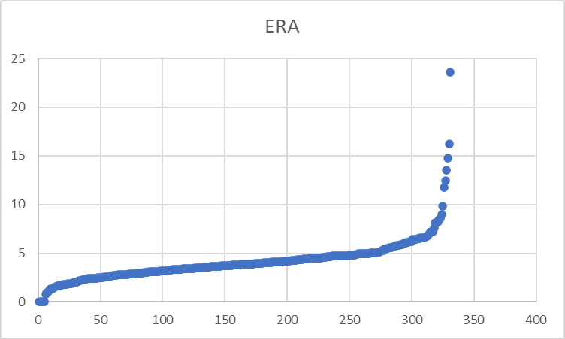
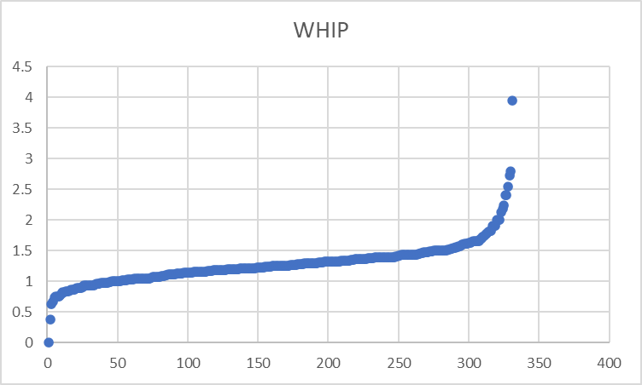
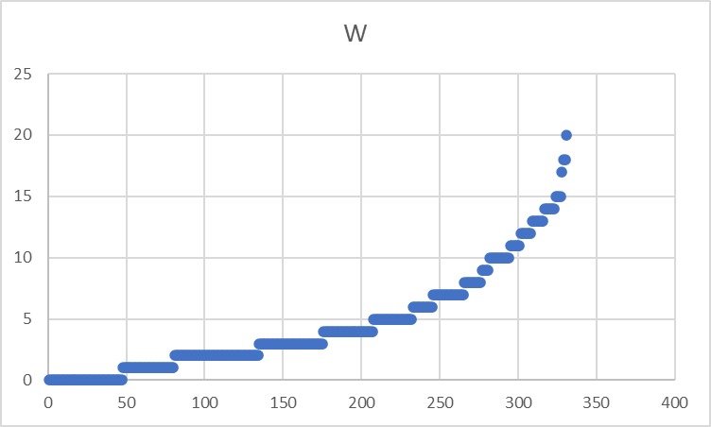
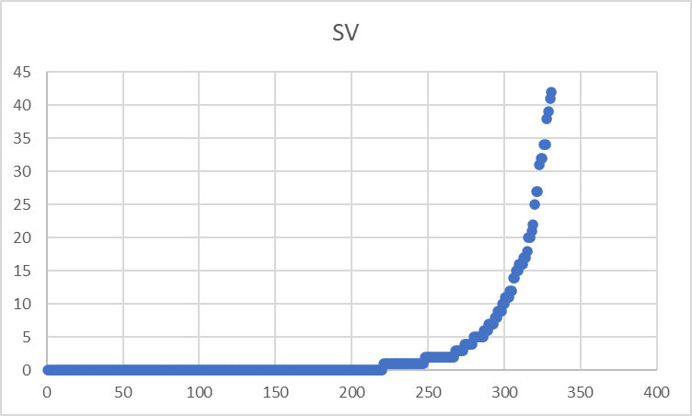
Pitcher Data Exploration
Looking at the shape of graphs
Notes:
Plotting the Stats in numerical order we find non-linear structure to the graphs
Some look exponential the others look polynomic

Slide 11
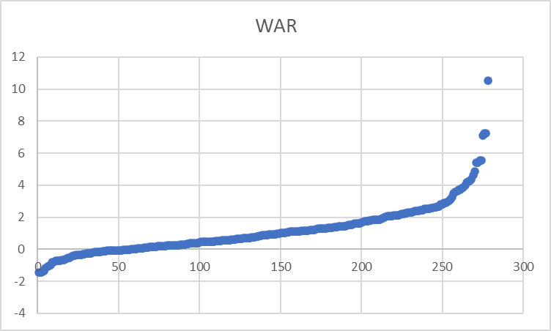
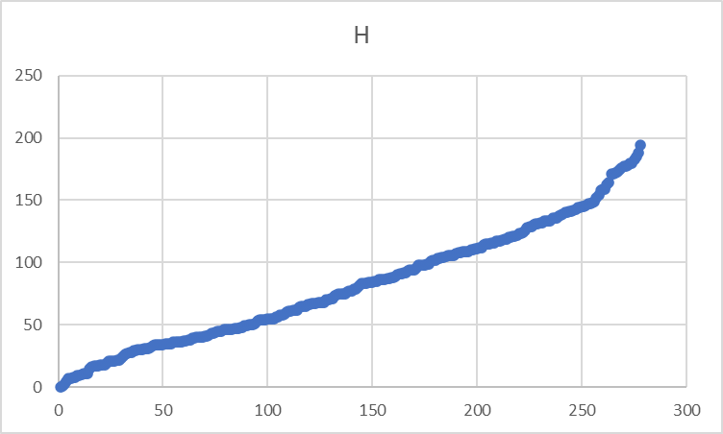
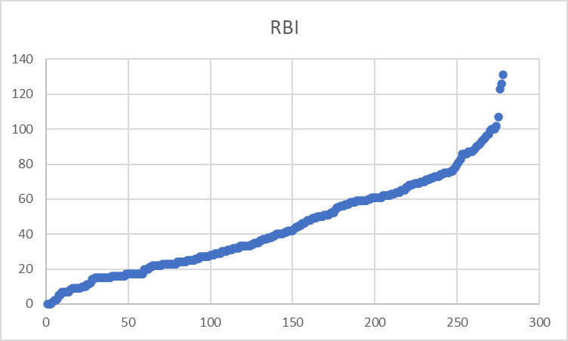
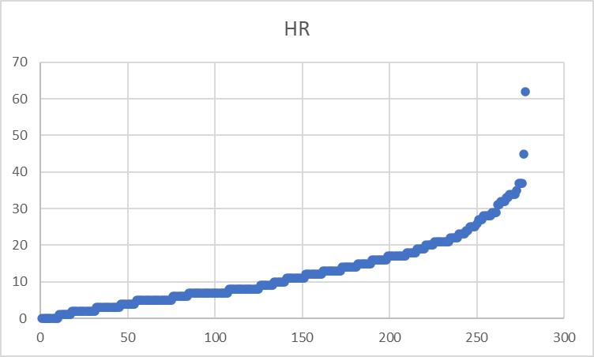
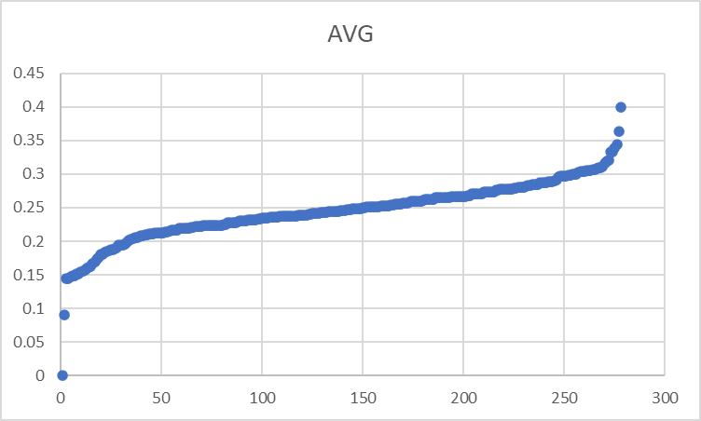
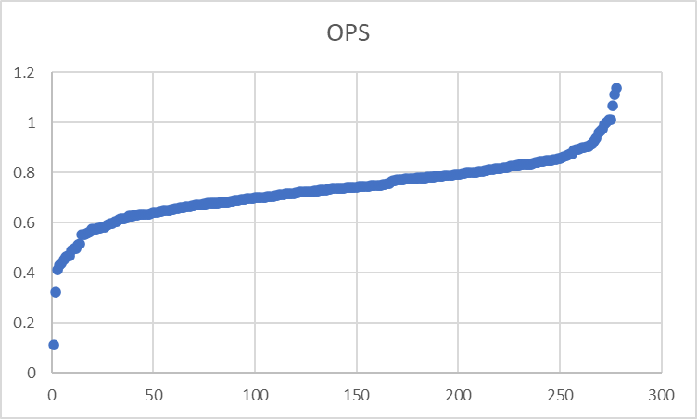
Position Player Data Exploration
Looking at the shape of graphs
Notes:
Same with batting stats

Slide 12
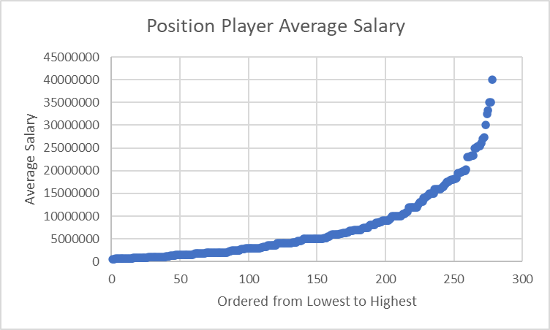
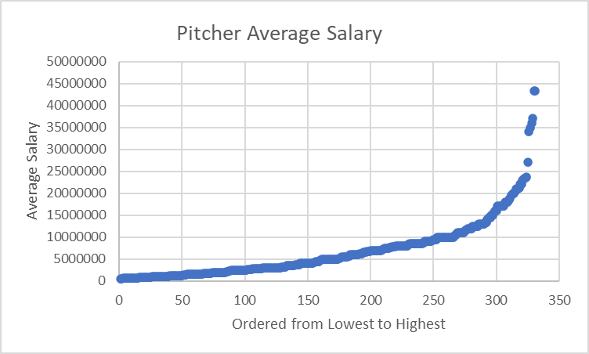
Salary Data Exploration
Shape of the graphs look exponential
Notes:
Now our DV
And looking at Salary plotted in numerical order we find it looks exponential.
Unfortunately, I realized this within the last week.

Slide 13
Analysis Methods
Stepwise Exponential Regression
Method used to model the relationship between a dependent variable and one or more independent variables that adds or removes predictor variables from the model in a step-by-step fashion.
Mediation
Analysis used to explore the indirect effect of an independent variable on a dependent variable through a variable with a causal relationship.
Moderation
Analysis that examines the influence of a third variable on the strength or direction of the relationship between an independent variable and a dependent variable.
Notes:
Stepwise Regression – is run in R and as it is processed over iterations it gauges how strong a relationship each independent variable has with all other variable
This then can remove variables that don’t affect the dependent variable significantly
Produces coefficients that tell us how Salary changes with respect to each variable
Mediation – Indirect keyword
Not as important but good to know
Regression of each individual variable with respect to WAR and compared to WAR + variable with respect to Salary
Moderation – Direct effect
Regression of WAR * each variable with respect to the Salary
This if significant is added to our formula for Salary

Slide 14
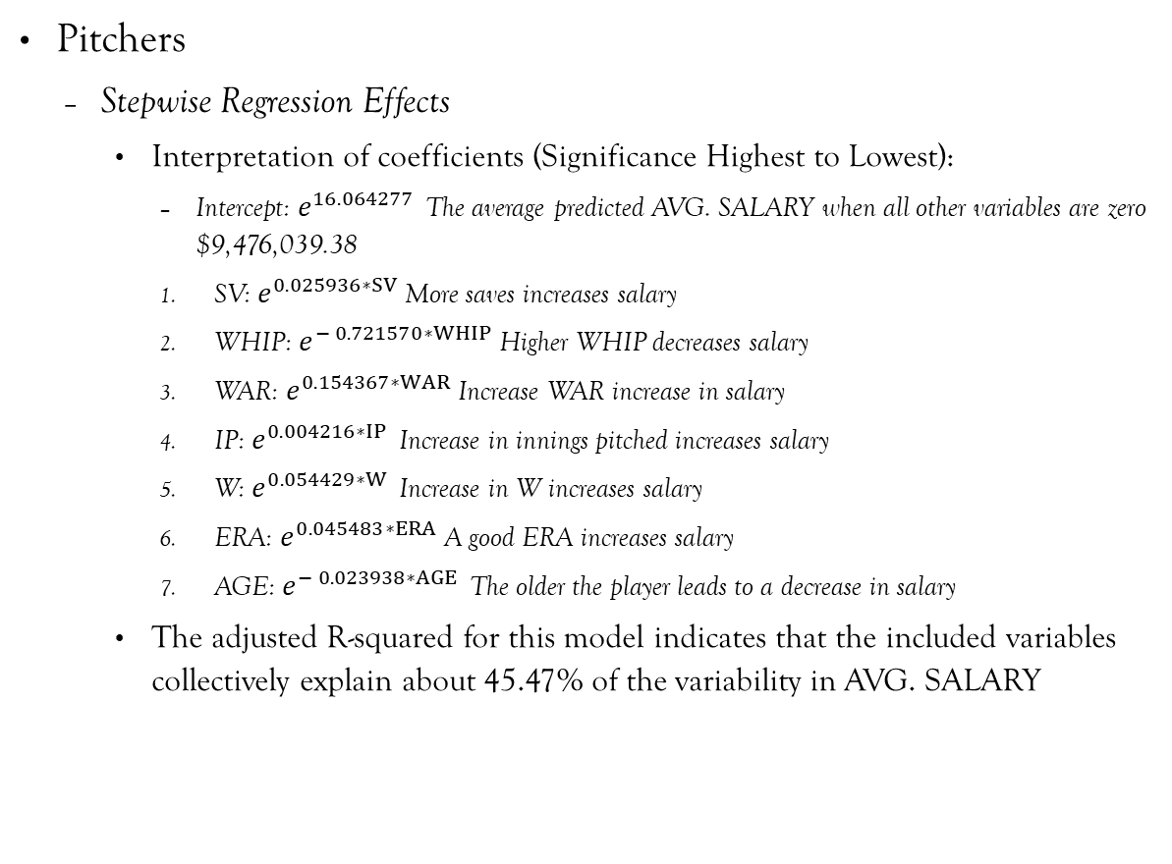
Exponential Regression Results
Pitchers
Stepwise Regression Effects
Interpretation of coefficients (Significance Highest to Lowest):
Intercept: $e^{16.064277 }$The average predicted AVG. SALARY when all other variables are zero $9,476,039.38
SV: $e^{0.025936∗SV}$More saves increases salary
WHIP: $e^{− 0.721570∗WHIP}$Higher WHIP decreases salary
WAR: $e^{0.154367∗WAR}$Increase WAR increase in salary
IP: $e^{0.004216∗IP }$Increase in innings pitched increases salary
W: $e^{0.054429∗W }$Increase in W increases salary
ERA: $e^{0.045483∗ERA}$A good ERA increases salary
AGE: $e^{− 0.023938∗AGE }$The older the player leads to a decrease in salary
The adjusted R-squared for this model indicates that the included variables collectively explain about 45.47% of the variability in AVG. SALARY
ln⁡(𝑃𝑟𝑒𝑑𝑖𝑐𝑡𝑒𝑑 𝑆𝑎𝑙𝑎𝑟𝑦) = 16.064277 + 0.154367∗WAR − 0.023938∗AGE + 0.004216∗IP + 0.045483∗ERA − 0.721570∗WHIP + 0.054429∗W + 0.025936∗SV
Notes:
Natural log is the inverse of exponential
Our formula is not quite ready we still need to look at moderation results

Slide 15
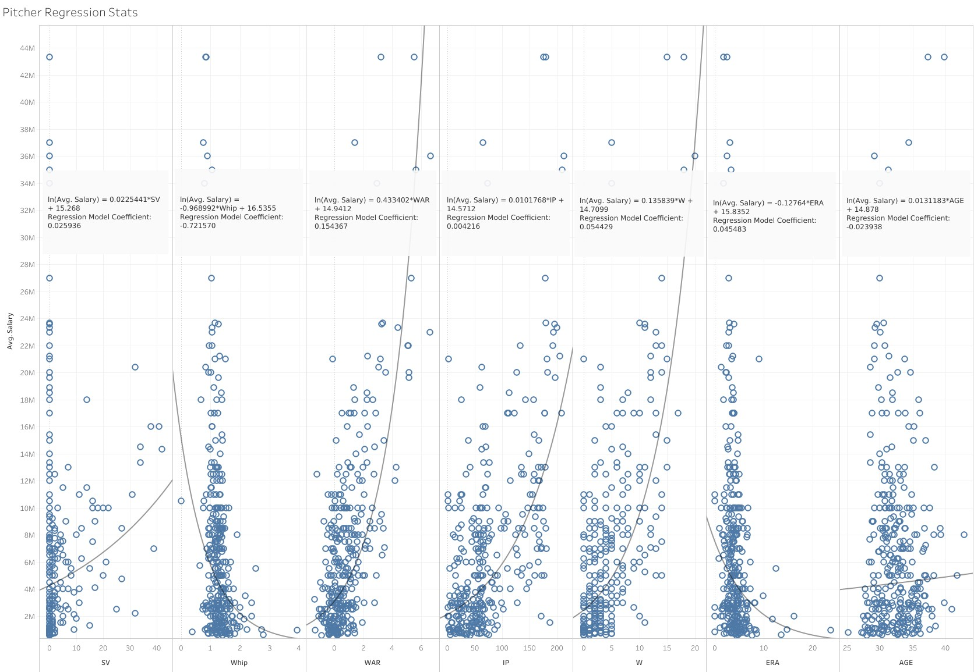
Exponential Regression coefficients vs actual Trend lines
Notes:
Here we are looking at the coefficients we just found with the exp regression compared with plotted exp trendlines on all variables

Slide 16
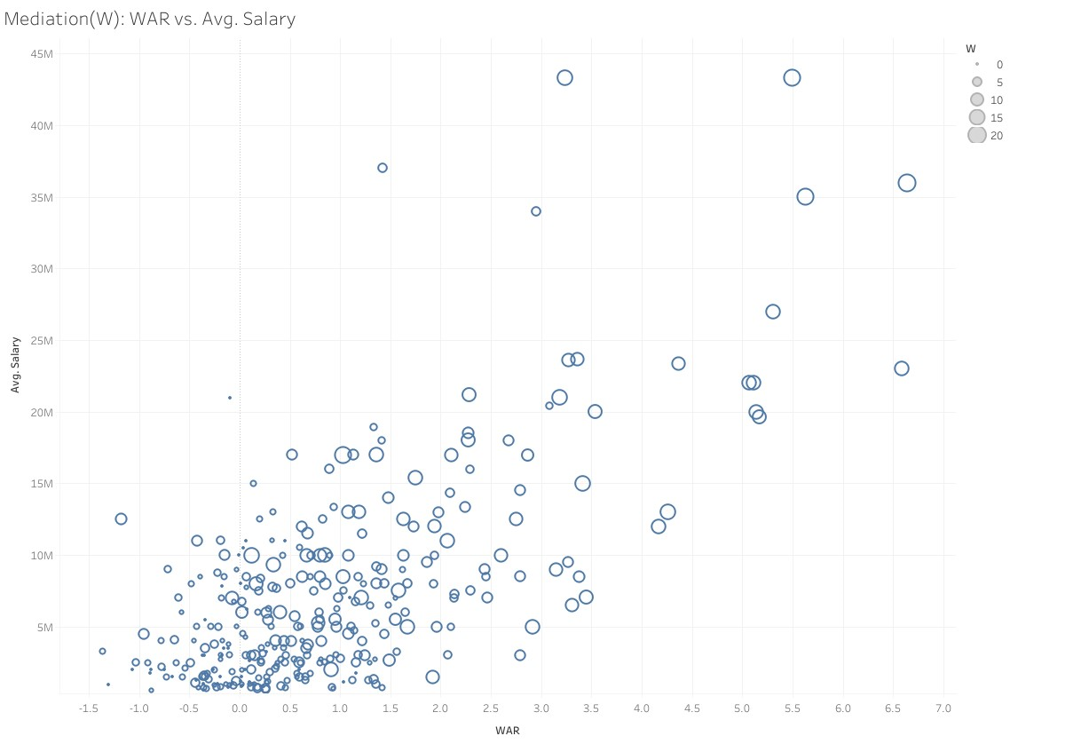
Mediation Analysis of W
Indirectly effects 45.2% WAR on Salary
Notes:
Mediation analysis assesses the mechanisms through which an independent variable influences a dependent variable.
While running mediation tests we found three variables with significance W, IP, WHIP
Analysis provides us effect of the
We find Average Causal Mediation Effect (ACME) effect with mediator
Average Direct Effect (ADE) effect with out mediator
Total Effect or overall effect
Proportion Mediated relation of ACME to the Total which is tells us how strong the mediator is
W increase with War and Salary

Slide 17

Mediation Analysis of IP
Indirectly effects 36.9% WAR on Salary
Notes:
IP increase with WAR and Salary

Slide 18
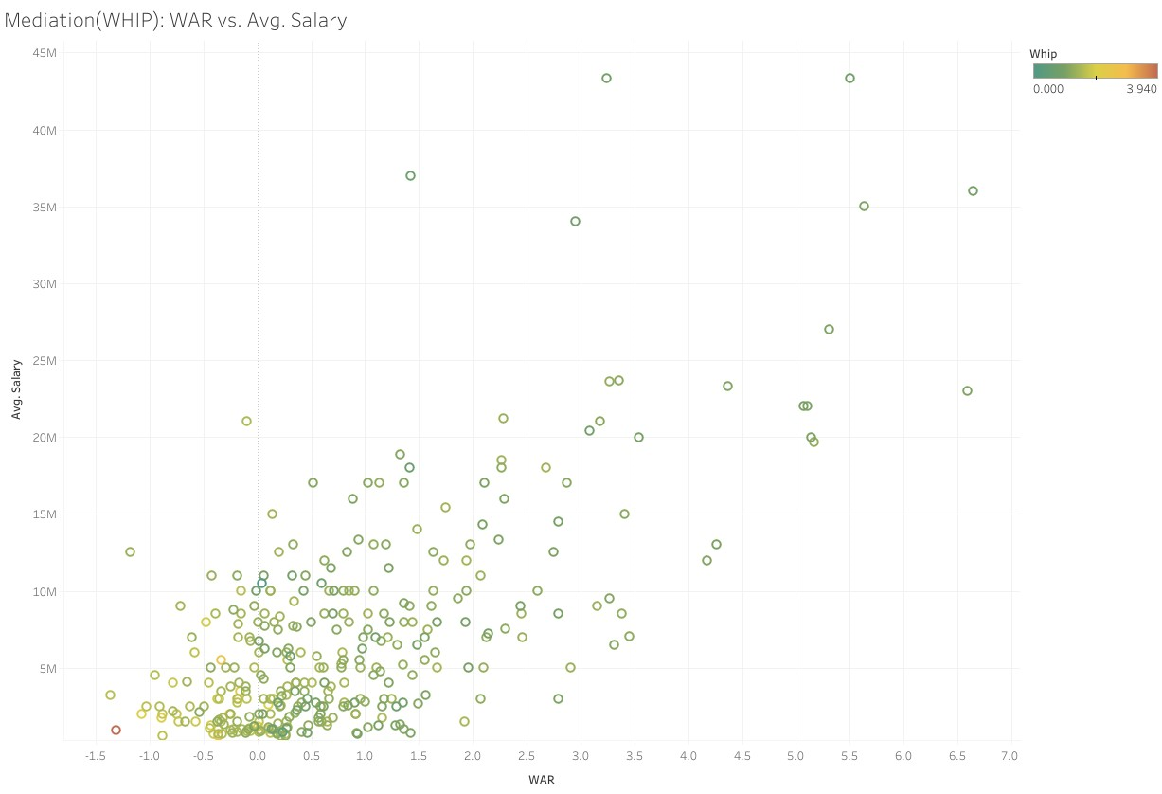
Mediation Analysis of WHIP
Indirectly effects 9.204% WAR on Salary
Notes:
Whip decrease with increase in WAR and Salary

Slide 19
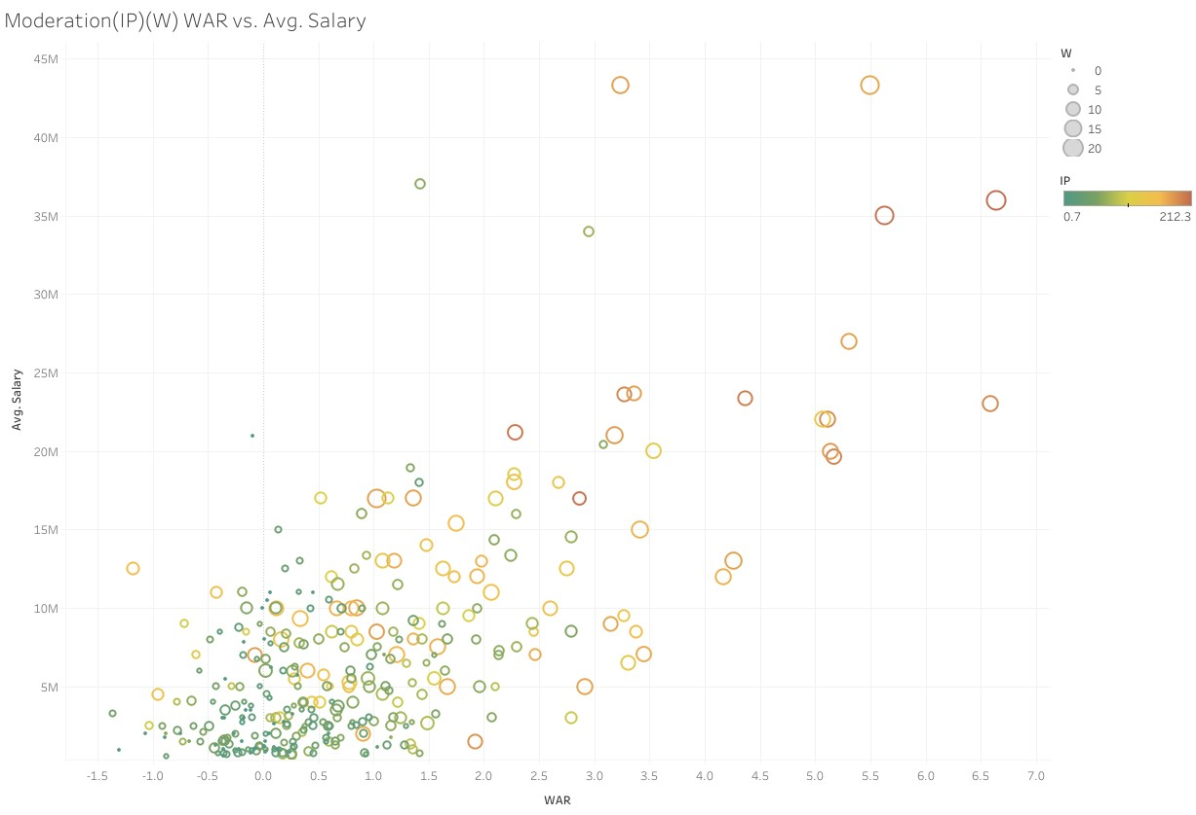
Moderation Analysis
IP
Coefficient: -0.0012974
Influences 39.66% on WAR and Salary
W
Coefficient: -0.01393
Influences 40.07% on WAR and Salary
Notes:
Moderation analysis examines whether the relationship between two variables changes based on the level of a third variable.
While running two significant moderators were found IP and W
These will be added to our equation coefficients * War * moderator

Slide 20
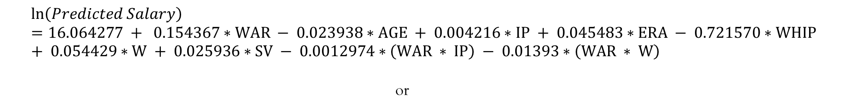
Predicted Salary Equation
$$\ln\left(Predicted Salary\right)=16.064277 + 0.154367∗WAR − 0.023938∗AGE + 0.004216∗IP + 0.045483∗ERA − 0.721570∗WHIP + 0.054429∗W + 0.025936∗SV − 0.0012974∗\left(WAR ∗ IP\right) − 0.01393∗\left(WAR ∗ W\right)$$
or
$$Predicted Salary=e^{(16.064277 + 0.154367∗WAR − 0.023938∗AGE + 0.004216∗IP + 0.045483∗ERA − 0.721570∗WHIP + 0.054429∗W + 0.025936∗SV − 0.0012974∗\left(WAR ∗ IP\right) − 0.01393∗\left(WAR ∗ W\right))}$$
Notes:
Our Formula is complete

Slide 21
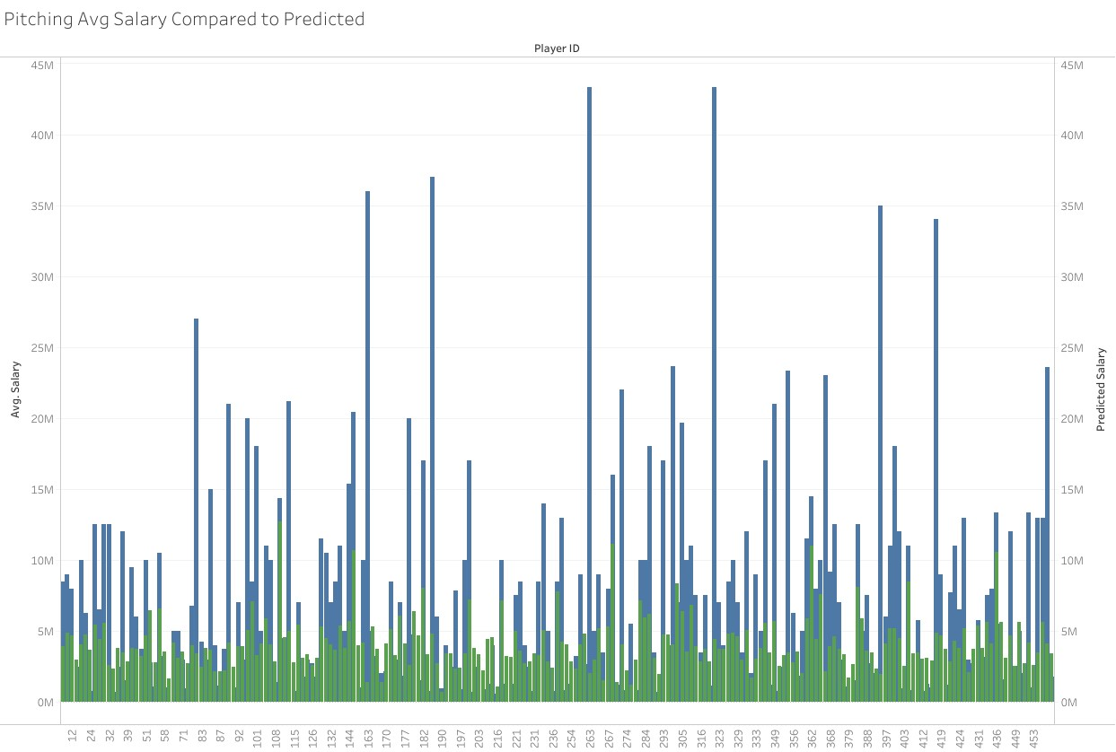
Comparison of Predicted vs. Actual
Notes:
Now we plot our predicted salary(green) with Avg Yearly Salary(blue)
So, its not perfect some are closer that others
Let's look at the error

Slide 22
Pitcher ERROR
Percent Error = ((Observed - Predicted)/Observed) *100%
Over the whole Pitching Dataset
Average Percent Error = -13.44%
Standard Deviation = 1.051311
Percent Difference = |Observed - Predicted|/[(Observed + Predicted)/2]
Over the whole Pitching Dataset
Average Percent Difference = 65%
Standard Deviation = .4261189
Notes:
Percent Error – How off our model is compared to Avg Yearly Salary
Percent Difference – Relative difference between each value
Our model underestimates the data 13% of the time
While the gap between the two sets is off by 65% yikes

Slide 23
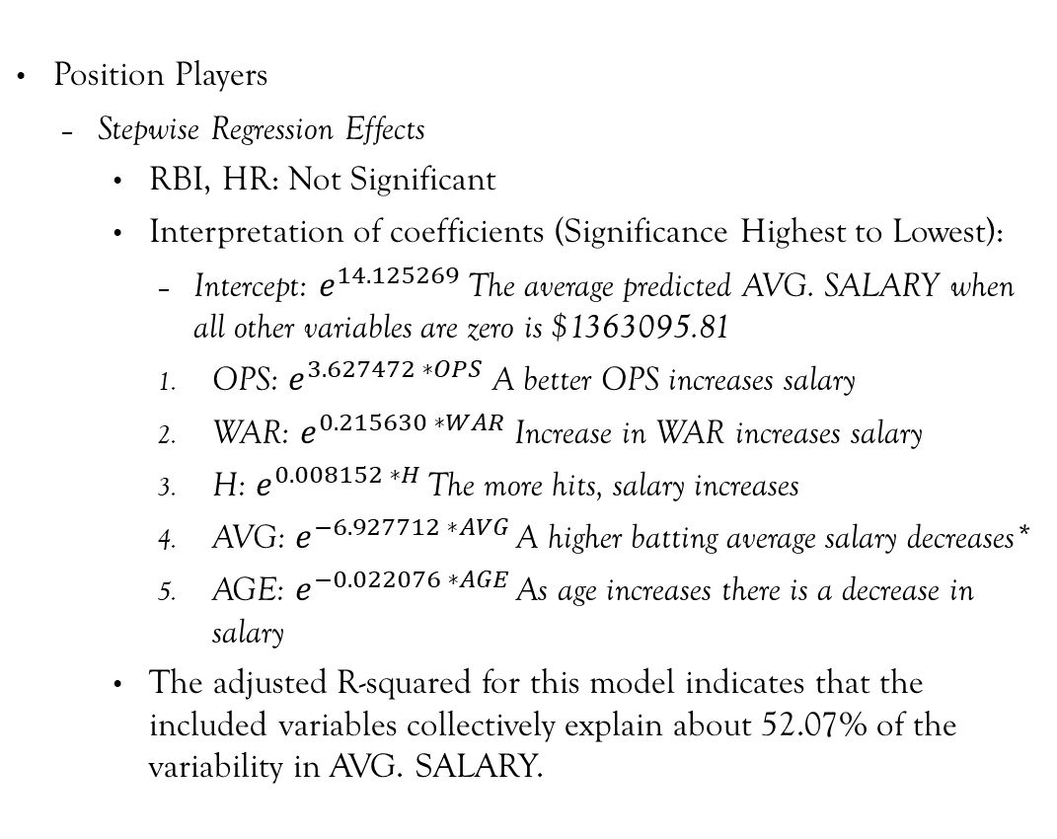
Exponential regression Results
Position Players
Stepwise Regression Effects
RBI, HR: Not Significant
Interpretation of coefficients (Significance Highest to Lowest):
Intercept: $e^{14.125269}$The average predicted AVG. SALARY when all other variables are zero is $1363095.81
OPS: $e^{3.627472 ∗OPS}$ A better OPS increases salary
WAR: $e^{0.215630 ∗WAR}$ Increase in WAR increases salary
H: $e^{0.008152 ∗H }$The more hits, salary increases
AVG: $e^{−6.927712 ∗AVG }$A higher batting average salary decreases*
AGE: $e^{−0.022076 ∗AGE }$As age increases there is a decrease in salary
The adjusted R-squared for this model indicates that the included variables collectively explain about 52.07% of the variability in AVG. SALARY.
ln⁡(𝑃𝑟𝑒𝑑𝑖𝑐𝑡𝑒𝑑 𝑆𝑎𝑙𝑎𝑟𝑦) =
14.125269 + 0.215630∗WAR − 0.022076∗AGE + 0.008152∗H − 6.927712∗AVG + 3.627472∗OPS
Notes:
On to Position Players
We do have an oddity in AVG typically we want our players to have a higher batting average

Slide 24
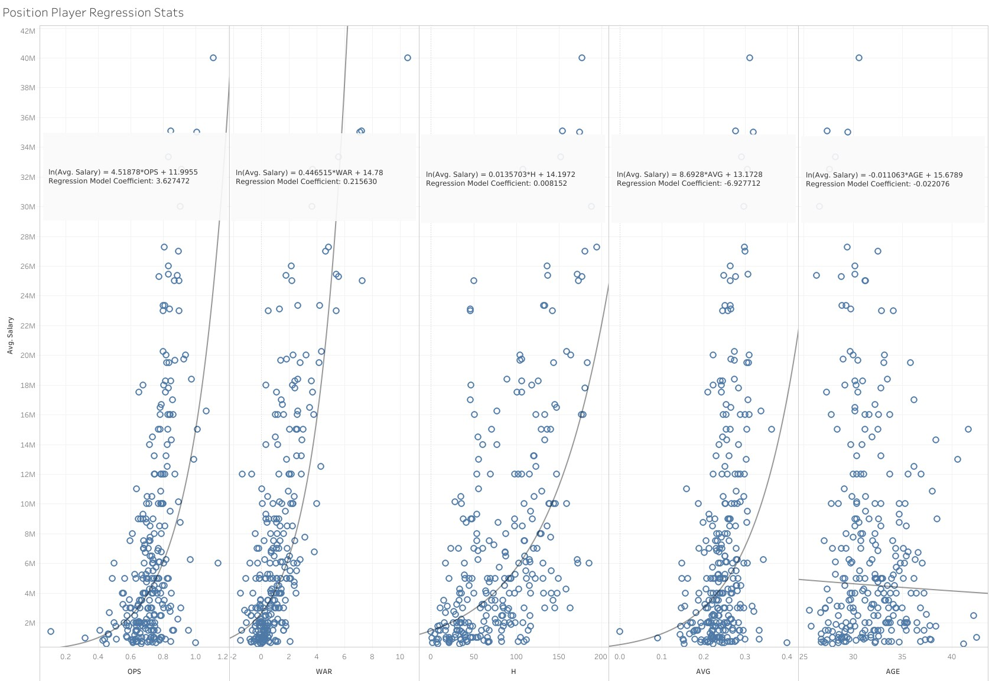
Exponential Regression coefficients vs actual Trend lines
Notes:
Again, we look at the coefficients we just found with the exp regression compared with plotted exp trendlines on all variables

Slide 25
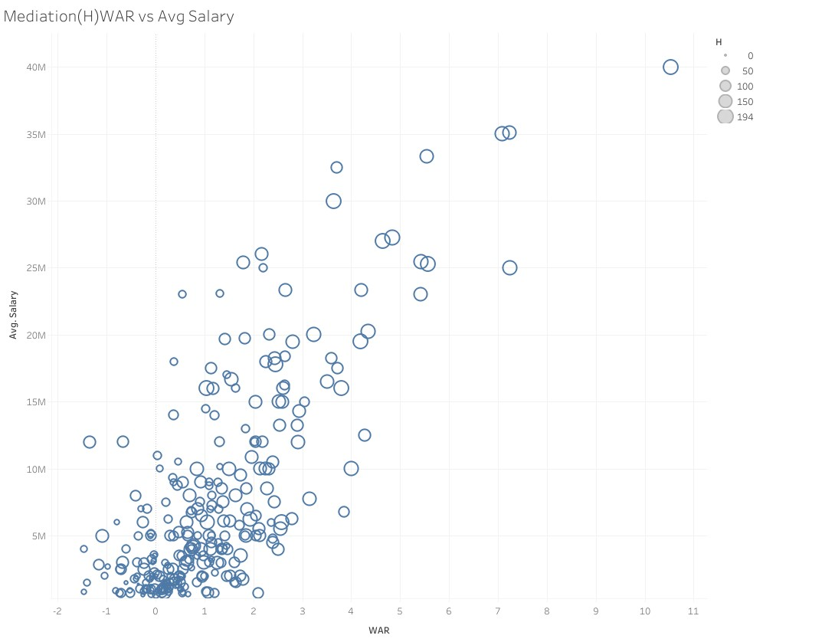
Mediation Analysis of H
Indirectly effects 30.30% WAR on Salary
Notes:
Only two mediators this time H and OPS

Slide 26
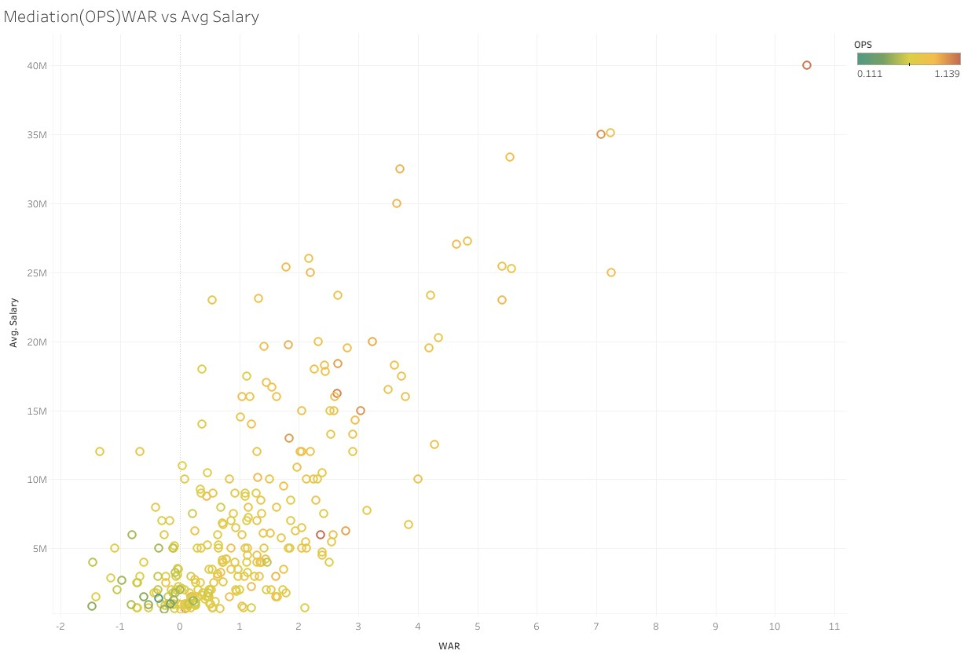
Mediation Analysis of OPS
Indirectly effects 17.05% WAR on Salary

Slide 27
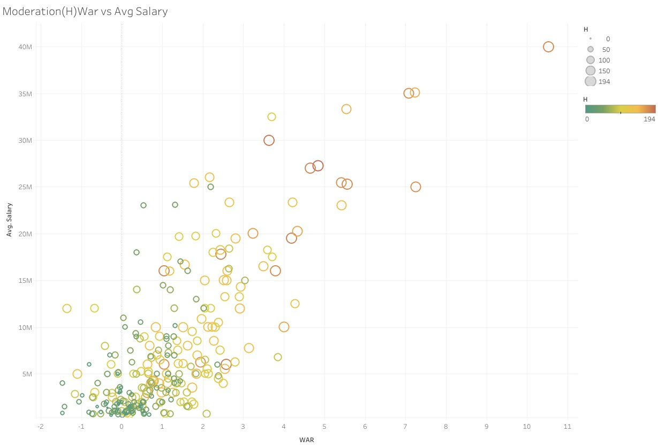
Moderation Analysis
H
Coefficient: -0.0018766
Influences 49.25% on WAR and Salary
Notes:
Only one moderator H

Slide 28
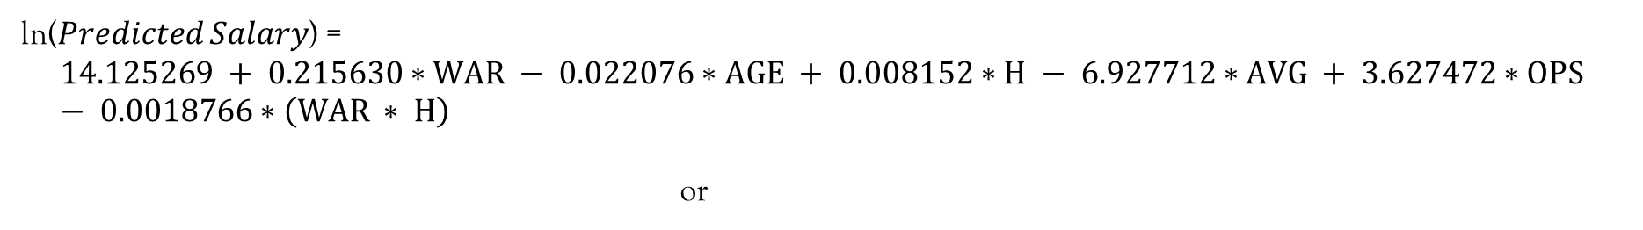
Prediction Equation
ln⁡(𝑃𝑟𝑒𝑑𝑖𝑐𝑡𝑒𝑑 𝑆𝑎𝑙𝑎𝑟𝑦) =
$$14.125269 + 0.215630∗WAR − 0.022076∗AGE + 0.008152∗H − 6.927712∗AVG + 3.627472∗OPS − 0.0018766∗\left(WAR ∗ H\right)$$
or
$$Predicted Salary=e^{(14.125269 + 0.215630∗WAR − 0.022076∗AGE + 0.008152∗H − 6.927712∗AVG + 3.627472∗OPS − 0.0018766∗\left(WAR ∗ H\right))}$$
Notes:
Now here is our Position player equation

Slide 29
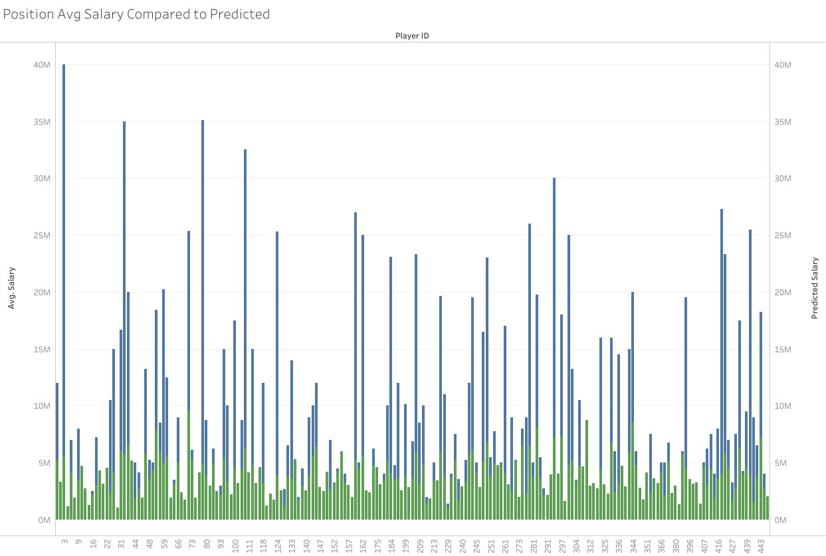
Comparison of Predicted vs. Actual

Slide 30
Position Error
Percent Error = ((Observed - Predicted)/Observed) *100%
Over the whole Position Player Dataset
Average Percent Error = - 8.75%
Standard Deviation = .09736621
Percent Difference = |Observed - Predicted|/[(Observed + Predicted)/2]
Over the whole Position Player Dataset
Average Percent Difference = 66%
Standard Deviation = .4149471
Notes:
Our model underestimates 8.75% of the time
While our spread is 66% off
Yeah, this needs fine tuning

Slide 31
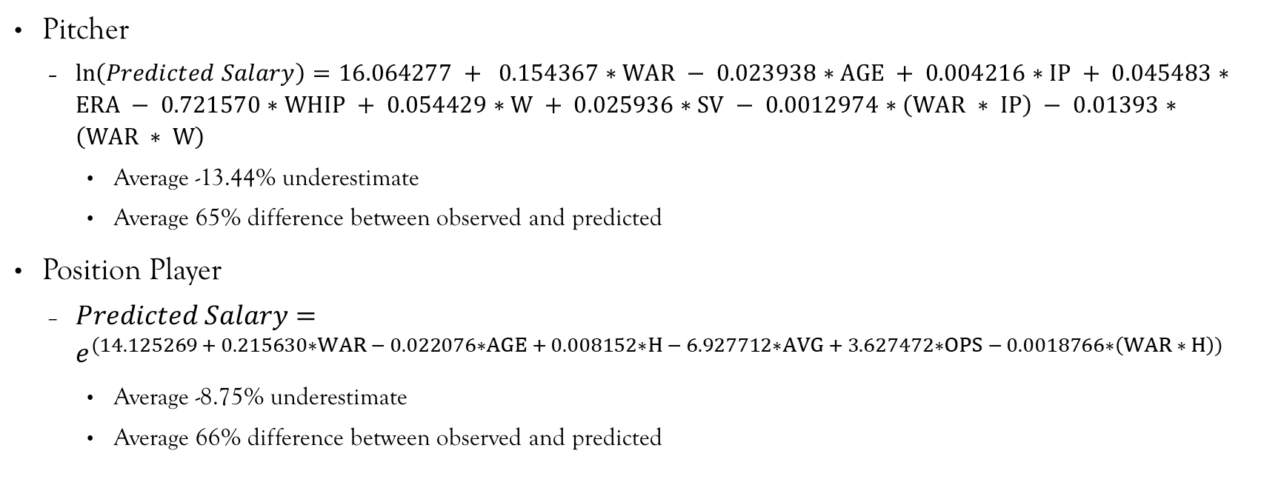
Summary
Pitcher
$\ln\left(Predicted Salary\right)=16.064277 + 0.154367∗WAR − 0.023938∗AGE + 0.004216∗IP + 0.045483∗ERA − 0.721570∗WHIP + 0.054429∗W + 0.025936∗SV − 0.0012974∗\left(WAR ∗ IP\right) − 0.01393∗\left(WAR ∗ W\right)$
Average -13.44% underestimate
Average 65% difference between observed and predicted
Position Player
$Predicted Salary=e^{(14.125269 + 0.215630∗WAR − 0.022076∗AGE + 0.008152∗H − 6.927712∗AVG + 3.627472∗OPS − 0.0018766∗\left(WAR ∗ H\right))}$
Average -8.75% underestimate
Average 66% difference between observed and predicted
Notes:
The model underestimates salaries on average and by a significant amount
Out of 331 pitchers 31(~1/10) were within 10% and 67 with 25%
Out of 278 position players 25(~1/12) were within 10%, and 58 within 25%

Slide 32
Conclusions
Given the Average Percentage Error
Fine tuning is required
Adding other statistic variables
Different regression models
Unknowns that can't be accounted for (Human Error)
Negotiation process
Over valuation
Still great for a front office to use just to get an idea if they are in or out on a player
Notes:
There are many other statistics that can be added and analyzed
Perhaps using a polynomic model or even a combination of models
There is the chance that a new statistic is need to analyze this properly

Slide 33

Questions?

Slide 34
Citations
2024 MLB Free Agents Tracker. (n.d.). Spotrac.com. https://www.spotrac.com/mlb/free-agents/
Standard Stats | Glossary | MLB.com. (n.d.). MLB.com. https://www.mlb.com/glossary/standard-stats
Advanced Stats | Glossary | MLB.com. (n.d.). MLB.com. https://www.mlb.com/glossary/advanced-stats
Zach. (2021, October 4). Exponential regression in R (Step-by-Step). Statology. https://www.statology.org/exponential-regression-in-r/
Ravelo, C. (2022, November 23). Stepwise Regression: What is it and should you use it? Statistics Solutions. https://www.statisticssolutions.com/stepwise-regression-what-is-it-and-should-you-use-it/
Fein, E. C. (2022, June 16). Section 7.3: Moderation Models, Assumptions, Interpretation, and Write up. Pressbooks. https://usq.pressbooks.pub/statisticsforresearchstudents/chapter/moderation-assumptions/

